Slide 1
Supporting and Enhancing Mathematics and Statistics
UNIT: Negative Numbers

Slide 2
UNIT:
Negative Numbers
Negative Numbers
Negative numbers are an important aspect of numeracy, particularly in the real world.
Here we will introduce the concept and show how they are used in calculations.
There are three sections in this Unit, namely:
Negative Numbers
Addition and Subtraction
Multiplication and Division

Slide 3
UNIT:
Negative Numbers
Positive and Negative Numbers
We start with a quick review of key facts:
Positive numbers are numbers greater than zero.
Negative numbers are numbers less than zero.
Zero is neither positive nor negative.
A number line illustrates positive and negative numbers.
Note: You can extend this number line as far as you
like/need in either direction.
-5 -4 -3 -2 -1 0 1 2 3 4 5

Slide 4
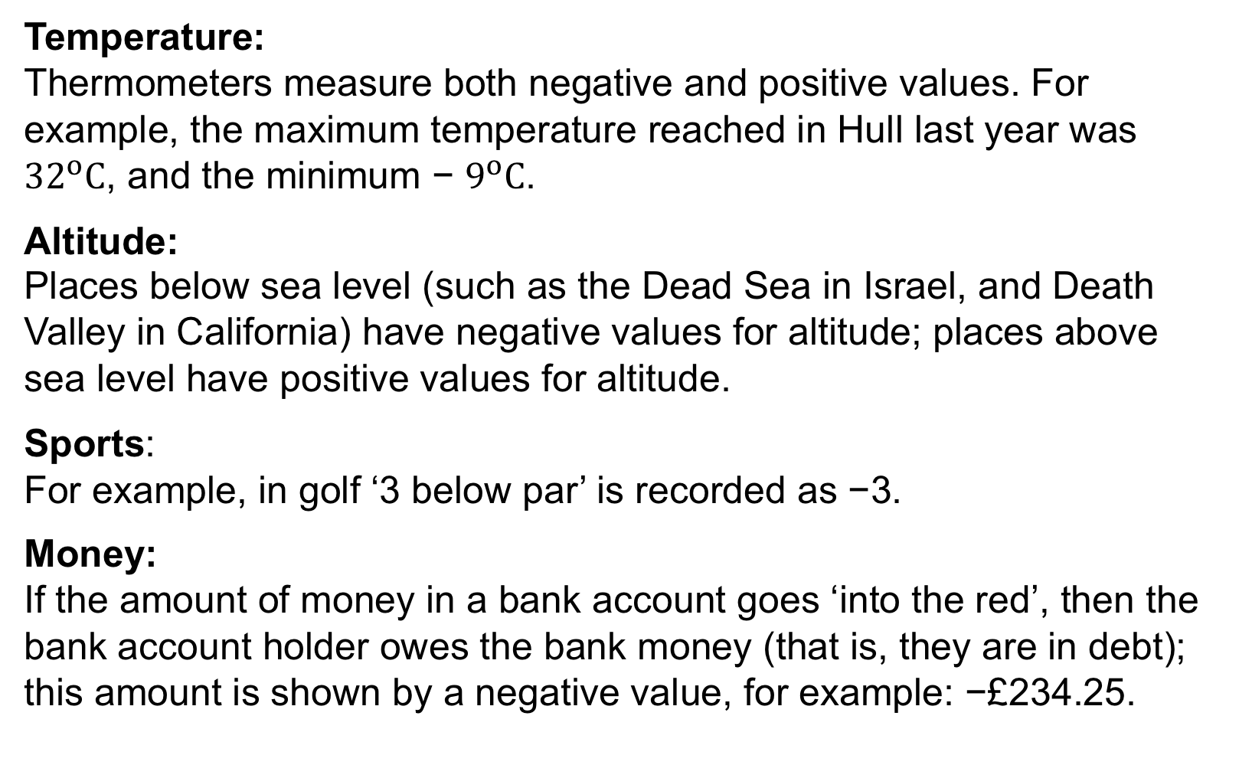
UNIT:
Negative Numbers
Section 1
Negative Numbers in Context
Temperature:
Thermometers measure both negative and positive values. For example, the maximum temperature reached in Hull last year was ${32}^{o}C$, and the minimum − $9^{o}C$.
Altitude:
Places below sea level (such as the Dead Sea in Israel, and Death Valley in California) have negative values for altitude; places above sea level have positive values for altitude.
Sports:
For example, in golf ‘3 below par’ is recorded as −3.
Money:
If the amount of money in a bank account goes ‘into the red’, then the bank account holder owes the bank money (that is, they are in debt); this amount is shown by a negative value, for example: −£234.25.

Slide 5
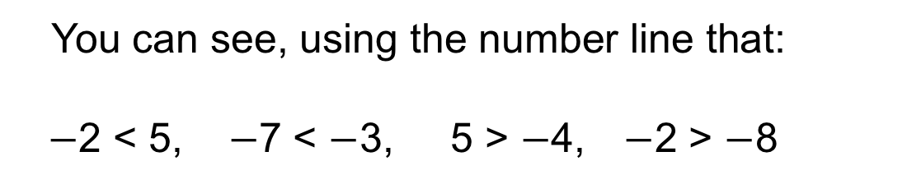
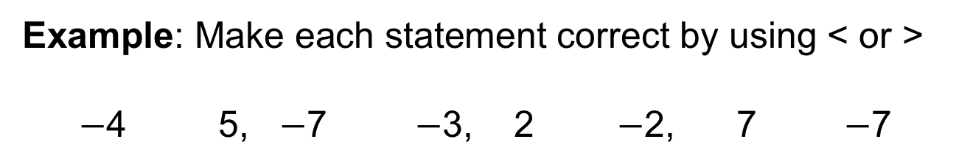
UNIT:
Negative Numbers
Section 1
Inequalities Signs
We also use inequality signs with negative numbers.
The sign < means “is less than” as, for example 4 < 7.
The sign > means “is greater than” as in 8 > 4.
You can see, using the number line that:
$−$2 < 5, $−$7 < $−$3, 5 > $−$4, $−$2 > $−$8
Example: Make each statement correct by using < or >
$−$4 5, $−$7 $−$3, 2 $−$2, 7 $−$7
<
<
>
>

Slide 6

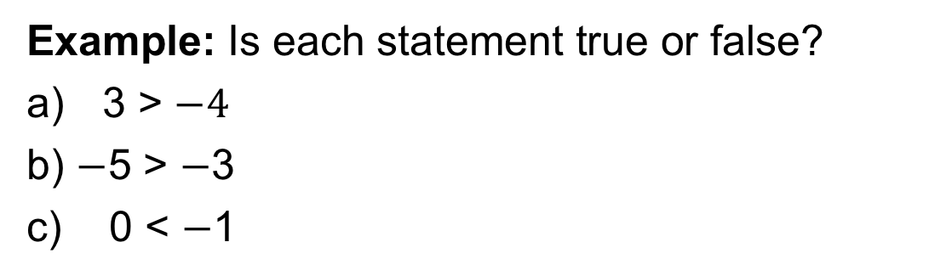
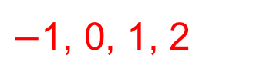
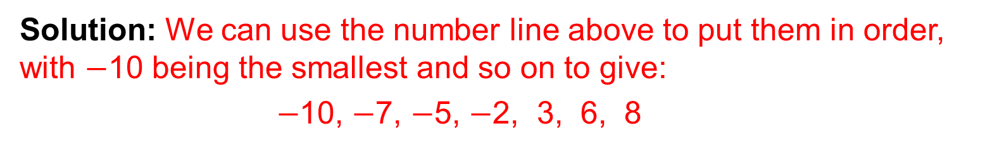
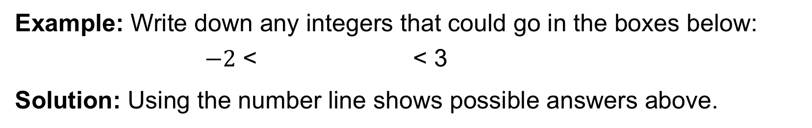
UNIT:
Negative Numbers
Section 1
Negative Numbers: Examples
Example: Write this set of numbers in order with the smallest first:
6, $−$7, 8, $−$2, $−$5, $−$10, 3
Solution: We can use the number line above to put them in order, with $−$10 being the smallest and so on to give:
$−$10, $−$7, $−$5, $−$2, 3, 6, 8
Example: Is each statement true or false?
3 > $−4$
b) $−$5 > $−$3
c) 0 < $−$1
This is true; 3 is the right of $−$4 on the number line
False as $−$5 is to the left of $−$3 on the number line
False as 0 is to the right of $−$1 so greater than $−$1
Example: Write down any integers that could go in the boxes below:
$−2$ < < 3
Solution: Using the number line shows possible answers above.
$−$1, 0, 1, 2

Slide 7

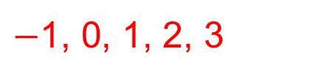
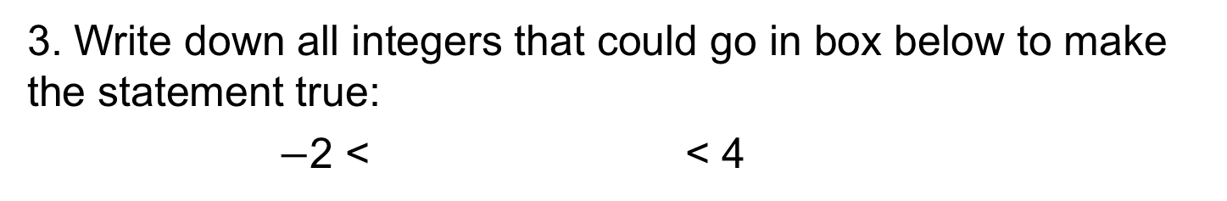
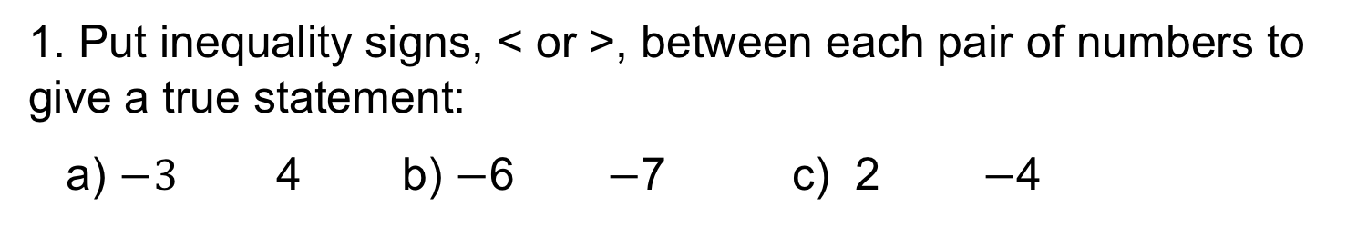
UNIT:
Negative Numbers
Section 1
Section 1: Fitness Check
1. Put inequality signs, < or >, between each pair of numbers to give a true statement:
a) $−3$ 4 b) $−$6 $−$7 c) 2 $−$4
<
>
>
2. Write the set of numbers in order with the smallest first: 3, $−2$, 8, 0, $−$1, 1, $−3$
Answer: $−3$, $−2$, $−1$, 0, 1, 3, 8
3. Write down all integers that could go in box below to make the statement true:
$−$2 < < 4
$−$1, 0, 1, 2, 3

Slide 8
UNIT:
Negative Numbers
Section 1
Section 1: Review
You have completed the first Section.
If you have completed and understood this section
click to start the next Section.
If you need more examples and interactive practice,
press here.
You might also find it helpful to look at:
Essential Information: press here

Slide 9
UNIT:
Negative Numbers
Section 2
Negative Numbers : Adding
Example: Calculate a) $−3+8 b) 4+(−2)$
Solution: a) We start at $−3$ and move 8 to the right so $−3+8$ = 5
b) We start at $4$ and move 2 to the left giving $4+\left(−2\right)=2$

Slide 10
UNIT:
Negative Numbers
Section 2
Negative Numbers: Subtracting
Example: Calculate a) $5−7 b) 4−(−2)$
Solution: a) We start at $5$ and move 7 to the left so $5−7$ = $−2$
b) We start at $4$ and move 2 to the right so $4−\left(−2\right)=6$

Slide 11


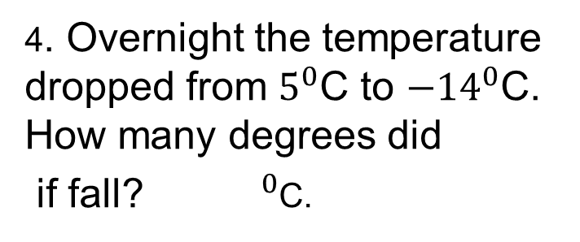



UNIT:
Negative Numbers
Section 2
Section 2: Fitness Check
1. Calculate: a)$−5+8$b) $−6+6$ c) 5 $−7$ d) 5 $−$ ($−6)$
Answers:
3
0
$−2$
11
2. Write down two possible sums shown below:
Answers: $−$2 + 5 = 3 and $−$2 $−$($−$5) = 3
3. Copy and complete
this addition table; the first row has been done.
$−$7$−$5 $−$3 $−$1 1
$−5−3 −1$ 1 3
4. Overnight the temperature dropped from $5^{0}$C to $−{14}^{0}$C.
How many degrees did
if fall? ${ }^{0}$C.
$−$3 $−$1 1 3 5
$−$1 1 3 5 7
19

Slide 12
UNIT:
Negative Numbers
Section 2
Section 2: Review
You have completed the second Section.
If you have completed and understood this section
click to start the last Section.
If you need more examples and interactive practice,
press here.
You might also find it helpful to look at:
Essential Information: press here

Slide 13
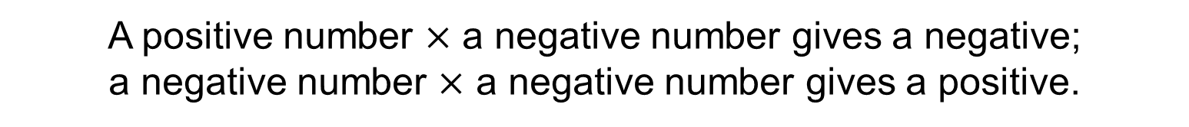
UNIT:
Negative Numbers
Section 3
Negative Numbers : Multiplication
A positive number $×$ a negative number gives a negative;
a negative number $×$ a negative number gives a positive.
Hence, for example: 5 $× \left(−7\right)=−35$and $\left(−8\right)$ $× \left(−7\right)=56$

Slide 14
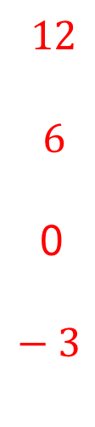
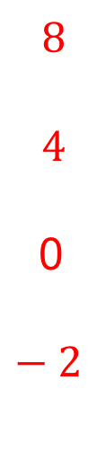
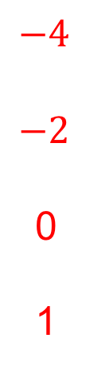
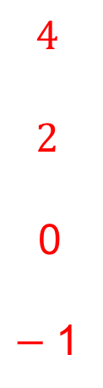
UNIT:
Negative Numbers
Section 3
Negative Numbers: Multiplication
Example: Complete this multiplication grid, working down the columns.
$$−4$$
$$−2$$
0
1
0
0
0
0
$$4$$
$$2$$
0
$−$1
$$8$$
$$4$$
0
$−2$
$$12$$
$$6$$
0
$−3$

Slide 15

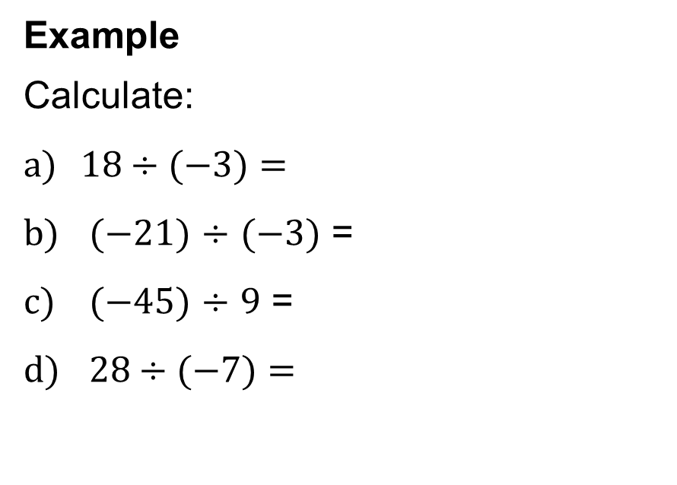


UNIT:
Negative Numbers
Section 3
Negative Numbers: Division
Division with negative numbers works in a similar way, as shown in these examples:
Example
Calculate:
$18÷(−3)=$
$(−21)$ $÷$ $(−3)$ =
$(−45)$ $÷$ $9$ =
$28÷(−7)=$
$$−6$$
7
$$−5$$
$$−4$$

Slide 16
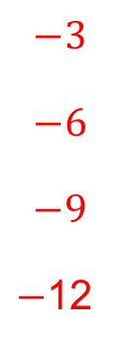



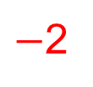
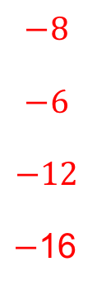
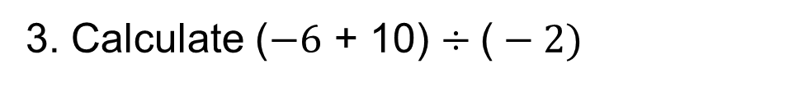

UNIT:
Negative Numbers
Section 3
Section 3: Fitness Check
1. Copy and complete this multiplication grid:
$$−1$$
$$−2$$
$$−3$$
$$−4$$
$$−2$$
$$−4$$
$$−6$$
$$−8$$
$$−3$$
$$−6$$
$$−9$$
$−$12
$$−8$$
$$−6$$
$$−12$$
$−$16
2. Calculate these multiplications and divisions.
$−$2
$−18$
a) ($−6)×3$ b) ($−3)×$($−8)$ c) ($−6)÷3$ d) 8$÷$($−2)$
24
$$−4$$
3. Calculate ($−6$ + 10) $÷\text{(}−2)$
$$\text{(}−2)$$

Slide 17
UNIT:
Negative Numbers
Section 3
Section 3: Review
You have completed the third Section.
If you have completed and mastered this last section
click here for the Unit audit.
If you need more examples and interactive practice,
press here.
You might also find it helpful to look at:
Essential Information: press here

